Slide 1
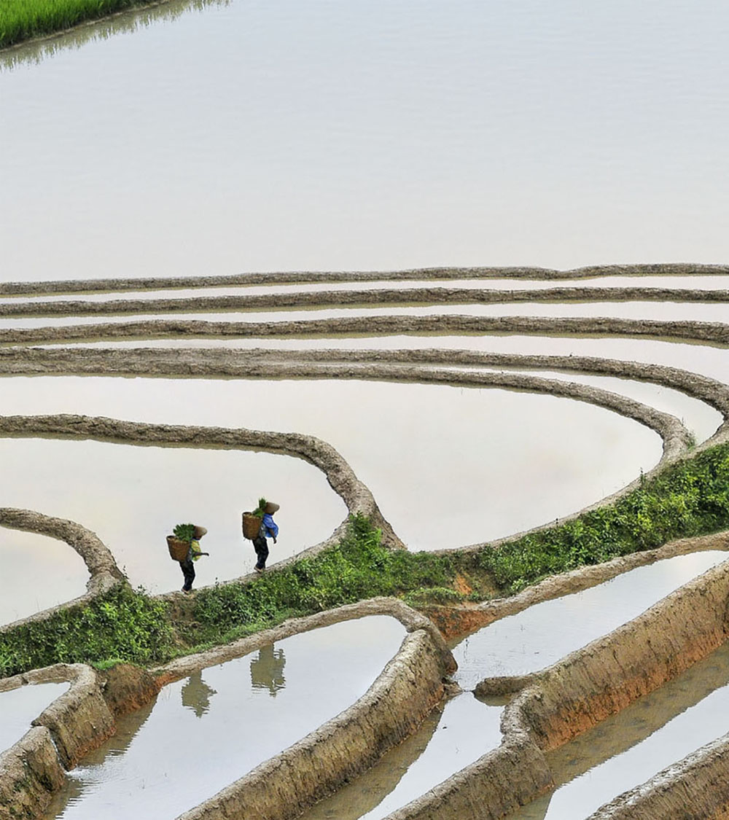
Domino Use Case at Bayer Crop Science
Sami Cheong PhD.
Data Scientist
Global IT Analytics

Slide 2
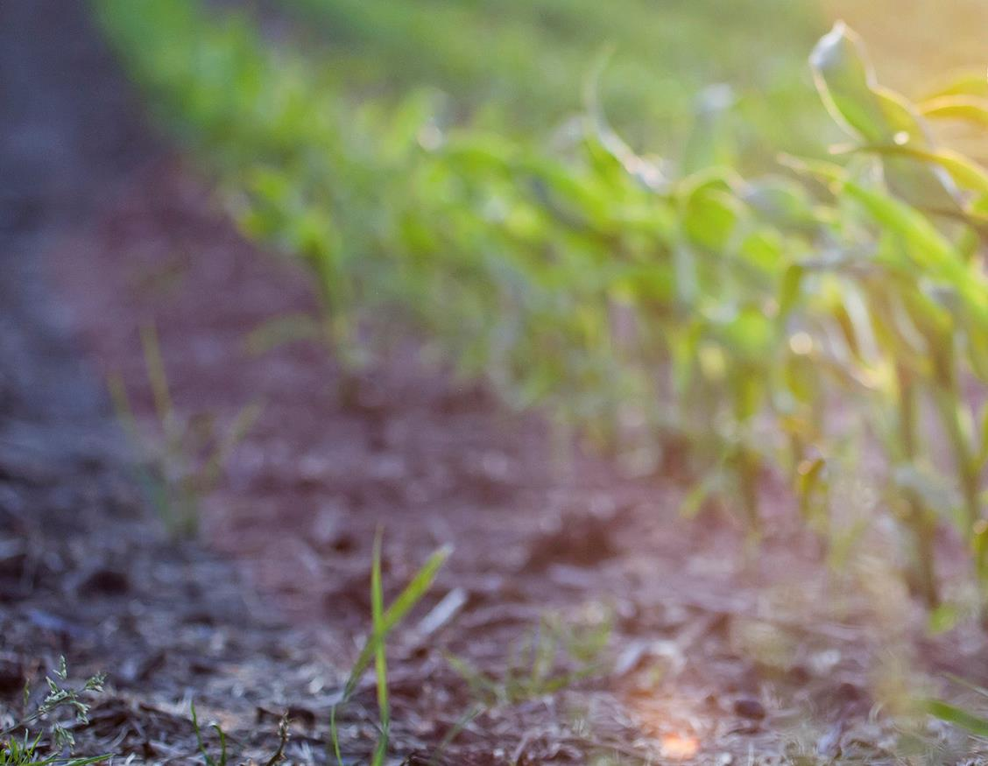


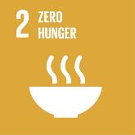















Better Lives
Bayer Crop Sciences TECHNOLOGIES
Crop Protection
YIELD
FARMER NEEDS
High Yield, Data-Driven Ag, Insect, Weed and Disease Control, Ag Biologicals
PEST CONTROL
Developing Solutions for Farmers
Plant Biotechnology
Better Planet
A grower makes
40⁺
key decisions each growing season
WEED CONTROL
Insect Control, Stress Tolerance, Seed Treatments, Digital Ag
DIGITAL ADVISORS
PLANT HEALTH
Ag Biologicals
Better Partner
ARTIFICIAL INTELLIGENCE
FERTILITY
Plant Breeding
Insect, Weed and Disease Control, Stress Tolerance, Digital Ag
2
Copyright Bayer

Slide 3
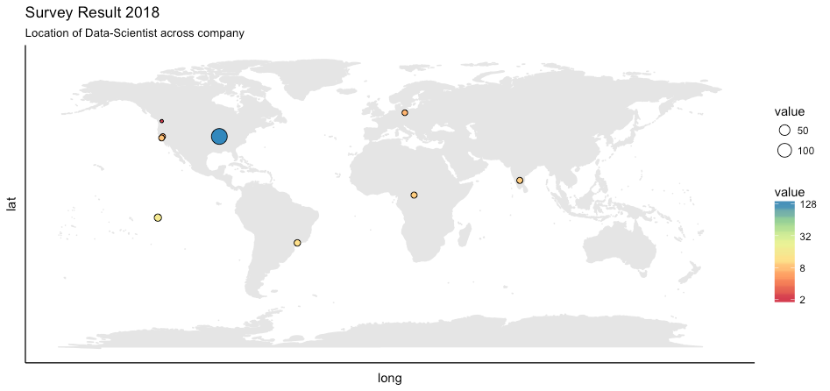




Data Science Community at Bayer Crop Science
500 + strong across the globe and growing
> 75 % Domino Adoption
Cross-functional collaborations to improve >100 decisions
Notes:
80% users have adopted Domino

Slide 4

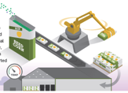
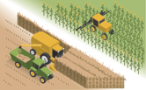
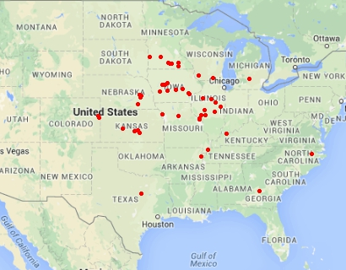
Use case : Smarter Production Decisions ​
Problem at hand
Performance Evaluation
Processing & Finishing
Planting & Harvesting
Production Planning

Slide 5

Use case : Smarter Production Decisions
Problem at hand
Performance Evaluation
Processing & Finishing
Relied on manual files
Planting & Harvesting
Little to no visualization
Production Planning
Fragmented decisions

Slide 6
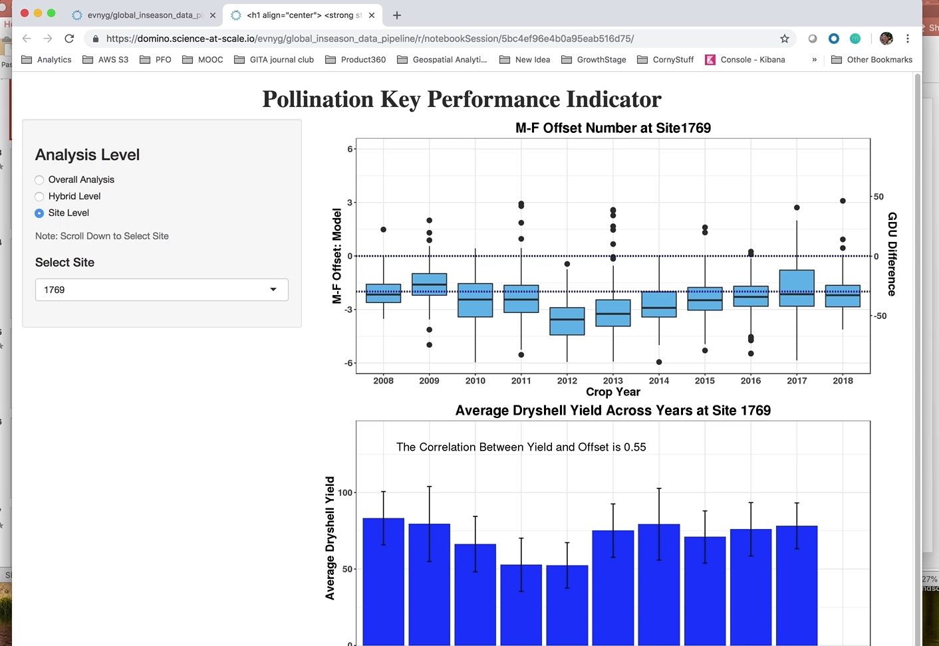
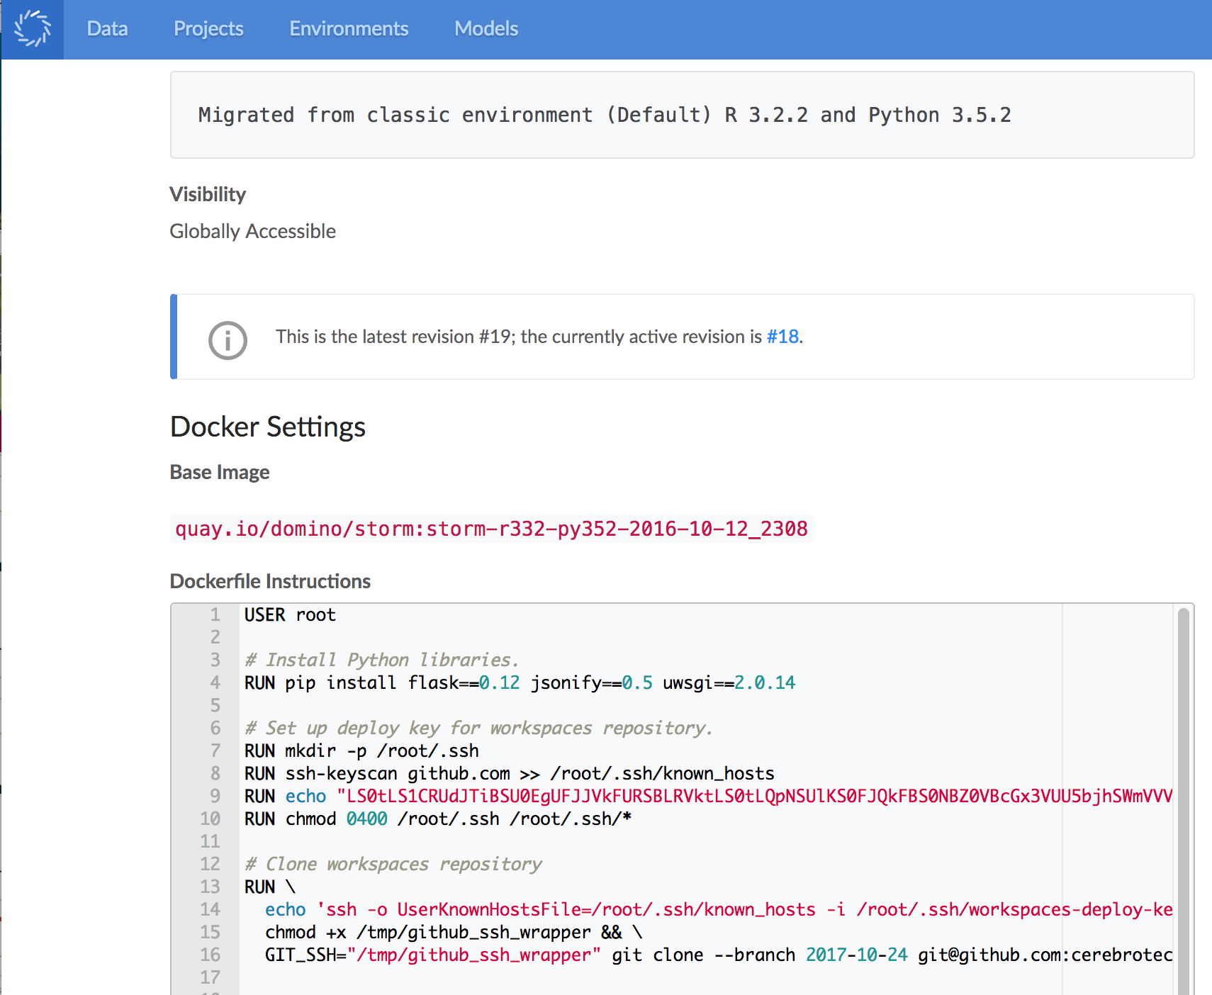
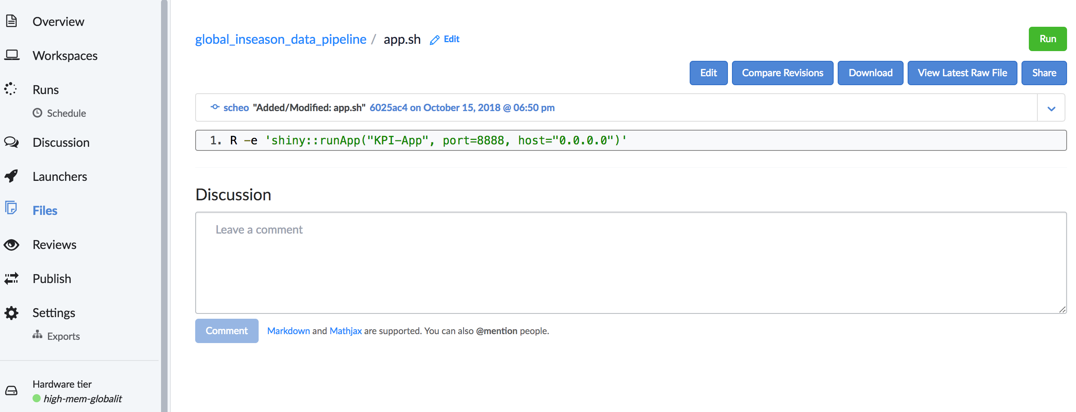

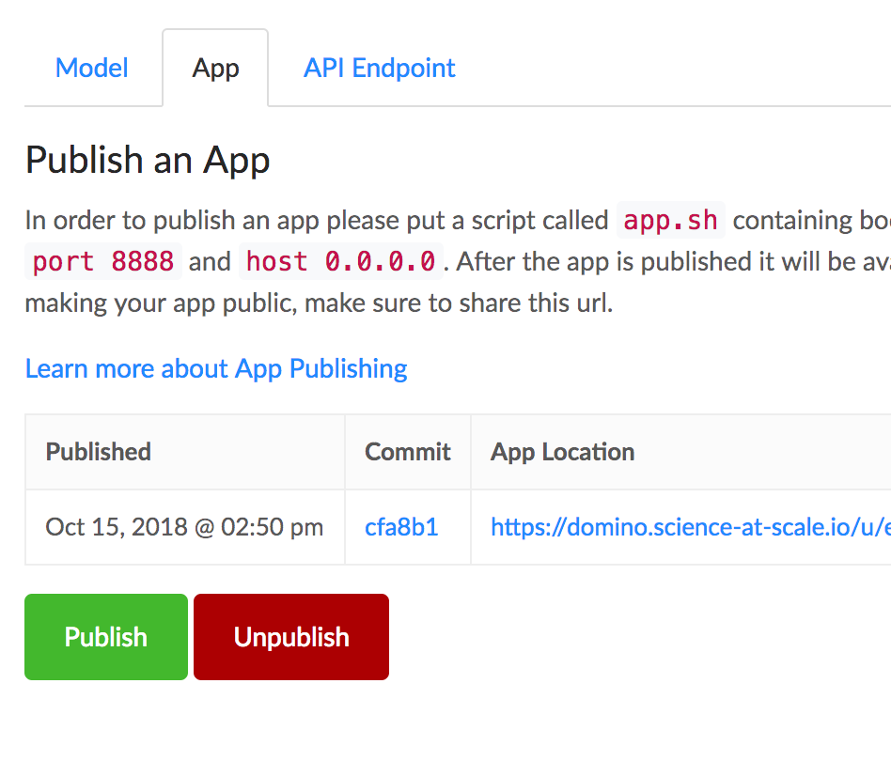
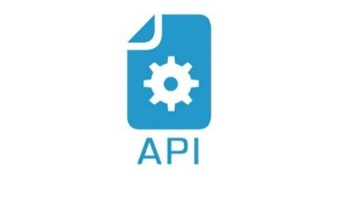



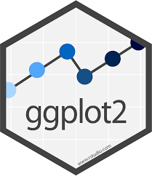

Use case : Smarter Production Decisions
Solution
Data wrangling
Model building
Visualization

Slide 7
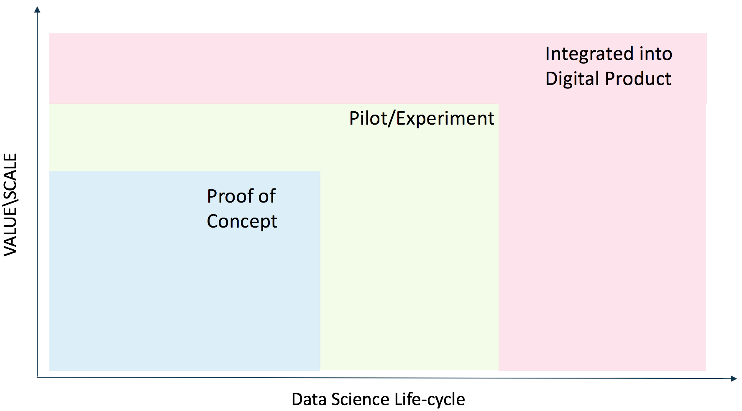




Use case : Smarter Production Decisions
Impact
Stakeholders
Convenient access to results reported with trackable, shareable visualization tool
Faster and smarter decisions
Data Scientists
Easily adjustable hardware and environment with centralized management
Empowered to focus on innovation and collaboration
Data Science Life-Cycle
Robust discovery environment
Model development accelerated with fast and light-weight experimentation

Slide 8
Use case : Involving stakeholders in model ops
Problem at hand
Performance Evaluation
Processing & Finishing
Planting & Harvesting
Production Planning

